Slide 1
Axway API Gateway Custom Filter

Slide 2
Contents
Introduction
Pre-requisites
Steps to create Custom Filter
Java Project structure
Installing Custom Filter
Demo

Slide 3
Introduction
Extend the capability of API Gateway by adding a custom filter.
Write your custom filter using the API Gateway developer extension kit
Using this approach, a fully integrated filter is created that has the API Gateway runtime capability and appears in the filter palette in Policy Studio

Slide 4
Pre-requisites
Java SE 8
Eclipse
API Gateway developer extension kit jars and third party jars if any

Slide 5
Steps to create Custom Filter
Step 1: Create the TypeDoc
Every filter has an associated XML-based TypeDoc description file that contains the entity type definition. It defines the configuration field names for that filter and the corresponding data types for that filter.
Step 2: Create the Filter class
Every message filter returns its corresponding Processor and Policy Studio classes.
Step 3: Create the Processor class
The Processor class is the API Gateway runtime component that is responsible for processing the message. Every message filter has an associated Processor and Filter class.

Slide 6
Steps to create Custom Filter
Step 4: Create the declarative UI XML file
The declarative XML file is used to define the user interface for filters and dialogs.
Step 5: Create the Policy Studio classes
All filters are configured using Policy Studio. Every filter has a configuration wizard that enables you to set each of the fields defined in the entity that corresponds to that filter.
FilterUI.java: This class lists the pages that are involved in a filter configuration window
filterPage.java:This class loads the declarative XML file which defines the layout of the visual fields on the filter's main configuration window
resoureces.properties: This file contains all text displayed in the GUI configuration window
gif: This image file is the icon that identifies the filter in Policy Studio

Slide 7
Steps to create Custom Filter
Step 6: Build the classes
When the classes are written, you must build them and add them to the API Gateway and client CLASSPATH. Example classes are included in the DEVELOPER_SAMPLES/jabber directory.
Step 7: Load the TypeDocs
You must register the TypeDoc created for the filter with the entity store.
Step 8: Construct a policy
Construct a policy that sends an instant message to an account on Google Talk and echoes a message back to the client. Use the GUI component of the newly added filter to specify its configuration and test the functionality of the filter (and its configuration).

Slide 8
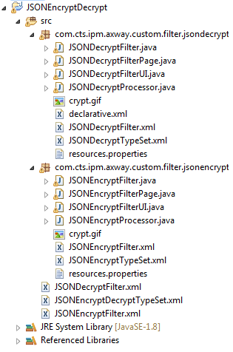
Java Project Structure

Slide 9
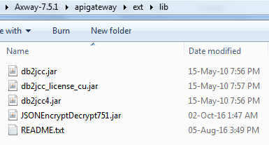
Installing Custom Filter
Compile the code and build the JAR
Add the new JAR and any third-party JAR files used by the custom filter to the CLASSPATH for all API Gateways and Node Managers on a host by copying them to the INSTALL_DIR/apigateway/ext/lib directory

Slide 10
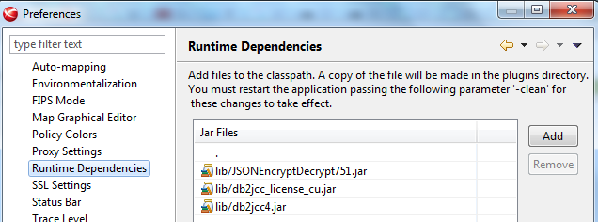
Installing Custom Filter
Add the new JAR and any third-party JAR files used by the custom filter to the runtime dependencies in Policy Studio. Select Window > Preferences > Runtime Dependencies, and click Add to browse to the new JAR and any third-party JARs, and add them to the list. Click Apply to save the changes.

Slide 11

Installing Custom Filter
Restart the API Gateway instances and Node Managers
Restart Policy Studio using the following command:
policystudio –clean
Register the type definition for the Custom Filter with the entity store using Policy Studio
Start Policy Studio, and connect to the API Gateway
Select File > Import > Import Custom Filters
Browse to the Typeset.xml file of the custom filter
Verify that the custom filter exist in the filter palette
Develop the policy using custom filter, deploy, and test the policy

Slide 12
Demo

Slide 13
Thank You

